Slide 1
IBM Data Science Capstone
Analysis of Toronto’s neighborhoods and demography to identify ideal location for starting a dedicated South Indian restaurant
Bhuvanesh Selvakumar

Slide 2
Introduction
The Tamil community (native to Southern India, Sri Lanka and Malaysia) are an important part of the Indian diaspora in Canada, and offer an ethnic cuisine that is unique and different from the mainstream Indian cuisine.
Many Indian restaurants in Canada include popular South Indian recipies in their menu, the traditional/native recipes are often ruled out due to the very small target population, their extreme flavor and spice variations.
With the growing Tamil population in Toronto coupled with the community's interest in expanding the commercial/culture outreach, the demand and potential of success in opening a dedicated South Indian restaurant is very high.

Slide 3
Problem Statement
An investor is considering the opportunity to open a South Indian restaurant in Toronto with a focus on offering authentic Tamil recipes along with popular Indian menu. The primary target customer base is the Tamil diaspora in Canada.
The objective is to identify neighborhoods with high Tamil population with limited/no business competition from other Indian restaurants, for starting a South Indian restaurant.

Slide 4
Data Required
To identify the neighborhoods with high probability of success opening a South-Indian restaurant for the Tamil community, the following datasets are required:
a. Neighborhoods: https://en.wikipedia.org/w/index.php?title=List_of_postal_codes_of_Canada:_M&oldid=1008658788
b. Demography: https://en.wikipedia.org/wiki/Demographics_of_Toronto_neighbourhoods
c. Activities: FourSquare API

Slide 5
Methodology – Data Mining
Data on Toronto's demography, neighborhoods and geo-locations were queried from the following websites:
a. Neighborhoods: https://en.wikipedia.org/w/index.php?title=List_of_postal_codes_of_Canada:_M&oldid=1008658788
b. Demography: https://en.wikipedia.org/wiki/Demographics_of_Toronto_neighbourhoods
The "read_html" function was used to mine data on Toronto's neighborhoods, demography and postal codes from wikipedia.
The postal code data was then used to run the geocoder function to query latitude and longitude for each of the boroughs in Toronto.
The foursquare API function is used to generate insights on the neighborhoods and present them in a Folium map for visualization. Foursquare API function's venue search feature was used to generate event category list for each neighborhood

Slide 6
Methodology – Data Cleaning
Sort and organized the queried raw data into a structured dataframe; Concatenated columns and segregate data as necessary and required
Create a color trend for the neighborhoods in the dataframe based on ethnicity and neighborhood
The "split" and "strip" functions were used to extract the ethnicity data and tabulate them in separate columns
Suffixed the neighborhood name with city name (e.g. Rouge Hill, Toronto) to enhance the accuracy of geocoordinate search using geocoder function and event category search using FourSquare API

Slide 7
Methodology – Data Visualization
The neighborhoods are plotted on Toronto map using the "folium" function
the "rgb2hex" function was used to generate colors for each neighborhood based on secondary ethnicity and suburb region

Slide 8
Methodology – Data Processing & Analysis
Applied one hot encoding, data indexing and k-means clustering techniques to identify neighborhoods with high frequency of Indian restaurants and Tamil population
k-means clustering was implemented using the frequency of Indian restaurants as grouping criteria, to organize the data under 3 clusters
Restaurants with high Tamil population and low frequency of Indian restaurants is deemed desirable and ideal for investment
Integrated tabular data (data frames) and visual analysis (color-coded maps) to identify the neighborhoods with high probability of success opening a South Indian restaurant and present summary of recommendations

Slide 9
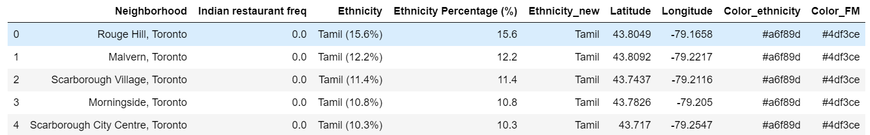
Results (1/4)
The top 5 neighborhoods for starting a South Indian restaurant along with their Tamil population composition is summarized below:

Slide 10
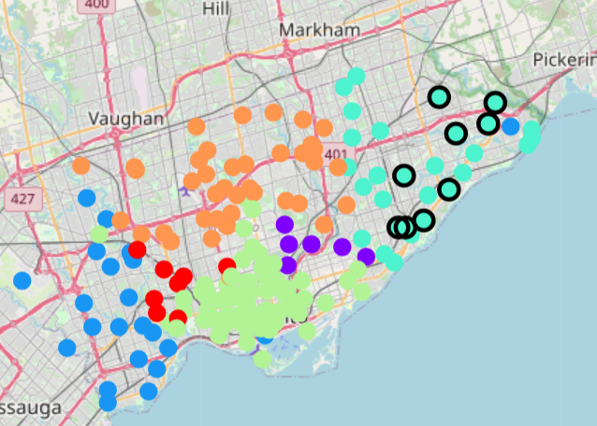
Results (2/4)
The following map highlights (black border) the neighborhoods that are ideal for starting a South Indian restaurant, with a focus on attracting Tamil population:

Slide 11
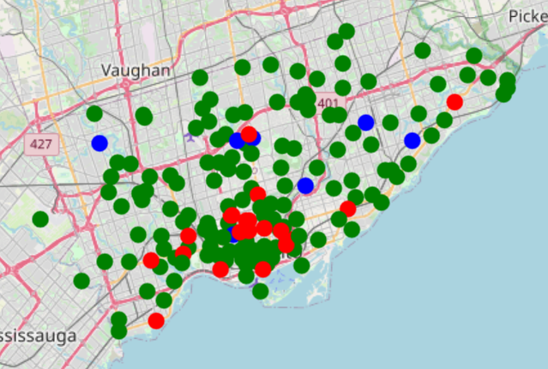
Results (3/4)
Results of k-means clustering (3 clusters):

Slide 12
Results (4/4)
Analyzing cluster #0 we learn that:
Most of the neighborhoods in Central/South-Western Toronto have a healthy concentration of Indian restaurants
Majority of the Indian restaurants would fit within this cluster bubble and are in the University district surrounding University of Toronto
Possibly the focus/target population are the International students from India
Analyzing cluster #1 we learn that:
The marked blue blips constitute the highest frequency of Indian restaurants and are distributed sparsely across the city.
Contrary to the popular expectation only 2 high frequency blips (Scarborough East, Eglinton) are in the Western part of the city, which have the high population of Tamils.
Can likely infer that the existing restaurants primarily target the larger population base who may be more interested in the popular Indian recipes, with limited interest in traditional South Indian recipes.
Analyzing cluster #2 we learn that:
Most of the neighborhoods in Toronto don't have any Indian restaurants (green blips), signaling that it's more of an exquisite cuisine and not a contemporary food preference.
Surprisingly, Western Toronto is densely populated with these green blips indicating lack of Indian/South-Indian restaurants that are near the Tamil community.
Flipping the green blips to red/blue would encourage the Tamil community to benefit from Indian restaurants without farther commute to Central/South-Western Toronto

Slide 13
Conclusions and Recommendations
1. Based on the above analysis, the top 5 locations to start a dedicated South-Indian restaurant with their corresponding Tamil population are:
a. Rouge Hill (15.6%)
b. Malvern (12.2%)
c. Scarborough Village (11.4%)
d. Morningside (10.8%)
e. Scarborough City Centre (10.3%)
2. The above neighborhoods offer competitive advantage as they don't have any Indian restaurants, thus increasing the probability of success
3. Most of the Tamil population is concentrated in Scarborough, which surprisingly has limited choice of Indian restaurants
4. The taxation, rules and business guidelines corresponding to the city of Scarborough would be in effect for the list of recommended locations

